Slide 1
Freelancing database
Xavier Green

Slide 2
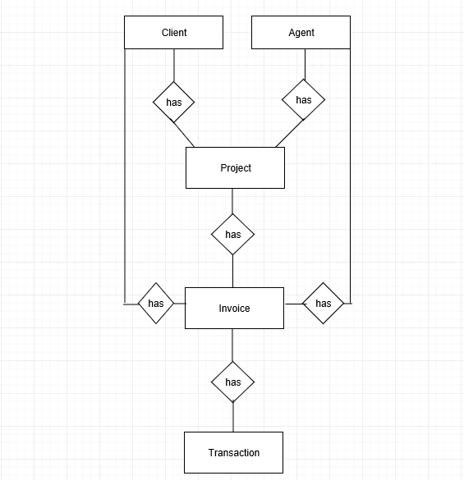
Updated ER DIAGRAM
-Removed client-agent relation
-Created relation between invoice-projects-client-agent
-Created relation between invoice-transaction
-Removed Cases table(Redundant for what I wanted to do)

Slide 3
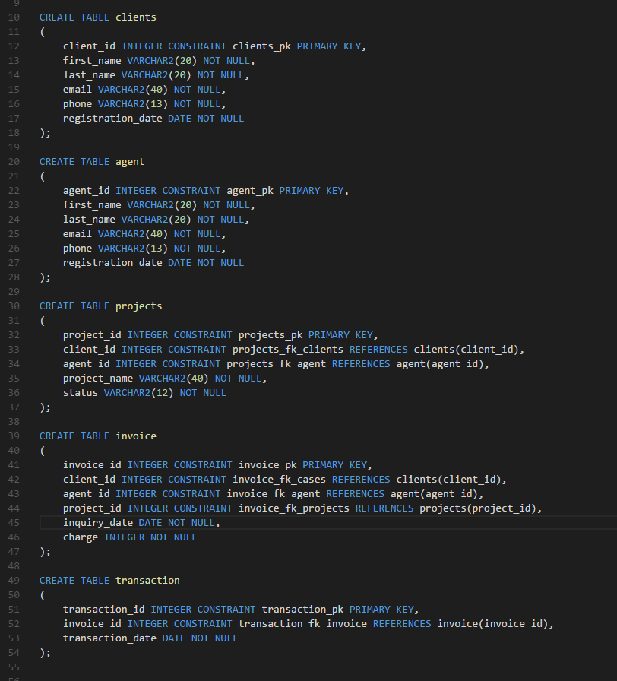
Table Creations
-Five Total Tables
-Clients request projects
-Agents pick and chose a project
-Projects stored in projects table, contains negotiable base pay
-Invoice is essentially the bill
-Transaction is billing history

Slide 4
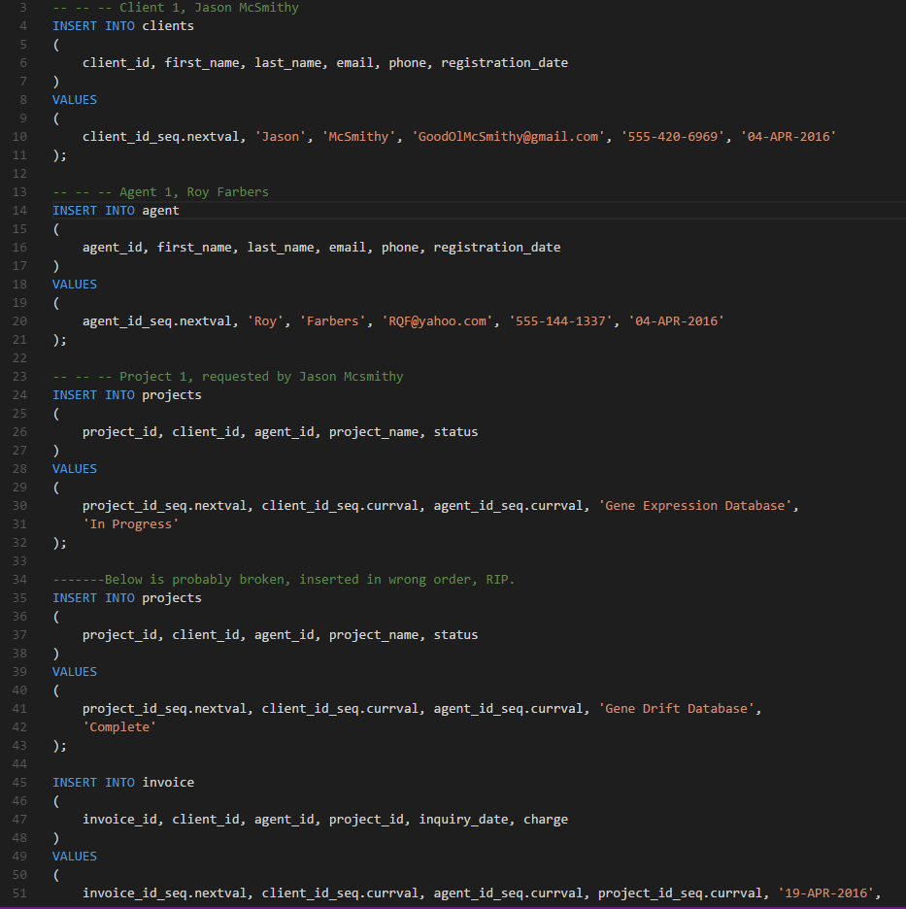
Scenario 1: Admin is required to add entities into the database
-Three clients
-Six agents
-Ten projects
-Four invoices
-Two transactions

Slide 5
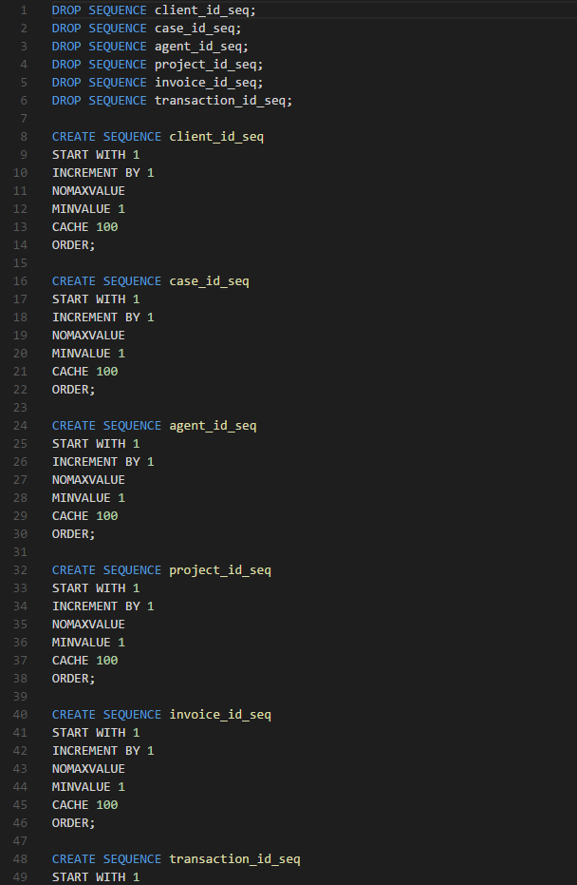
Sequences used to populate keys
-Used sequences to populate my primary keys.
-One used for each key.

Slide 6
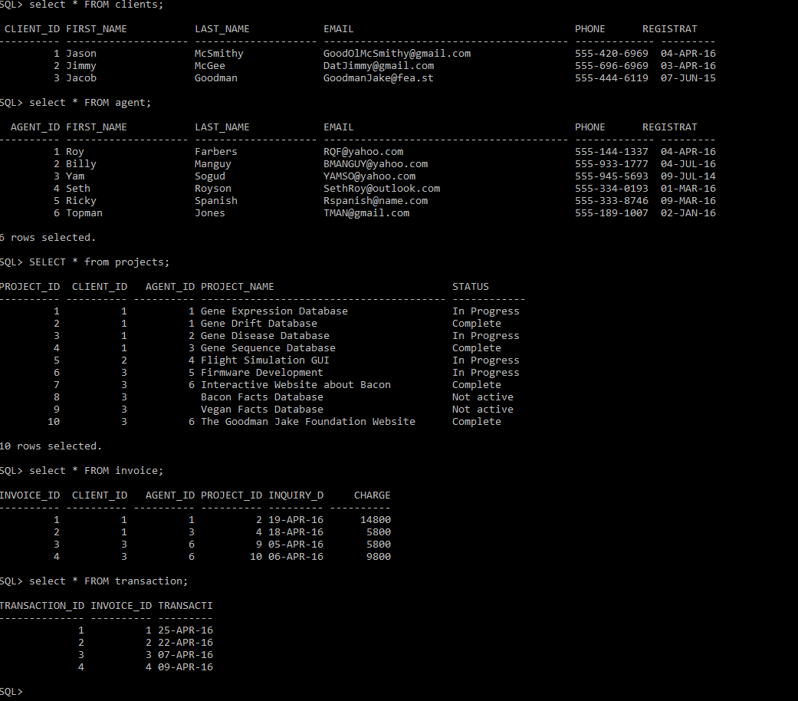
Table Insertions (output)

Slide 7
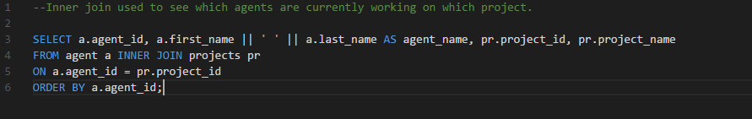
Scenario 2: User wishes to see which agent is working on which project.
-Done using inner join on two tables
-Joined agent and projects tables

Slide 8
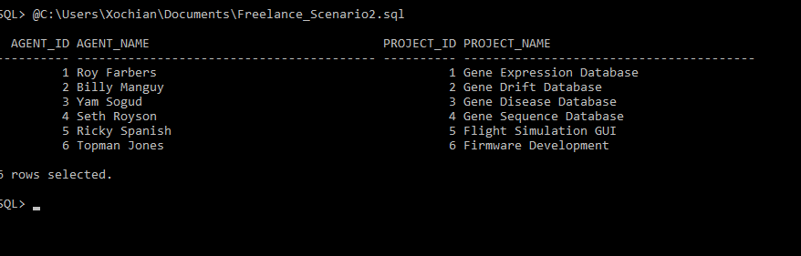
Scenario 2: (Output)

Slide 9
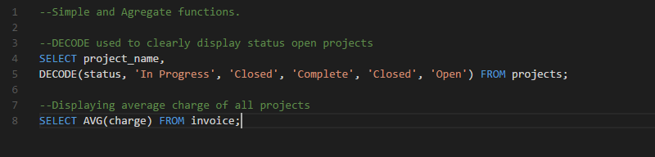
Scenario 3: User wishes to know which projects are open.
-One simple, one aggregate
-DECODE() used to clearly display open projects.
-DECODE() essentially an if-else statement
-AVG() used to find the average charge of all projects.

Slide 10
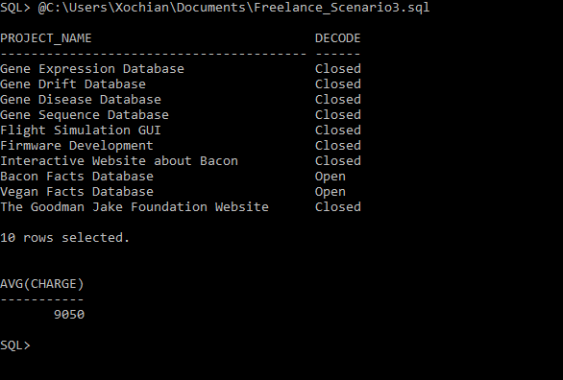
Scenario 3: (Output)

Slide 11
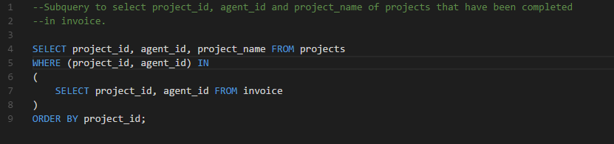
Scenario 4: Admin wishes to know which agent has completed and has reached invoice stage for projects.
-Subquery used on two tables
-Query displays project information on projects that have been completed.

Slide 12
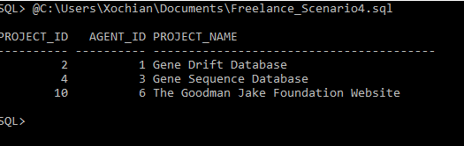
Scenario 4: (output)

Slide 13
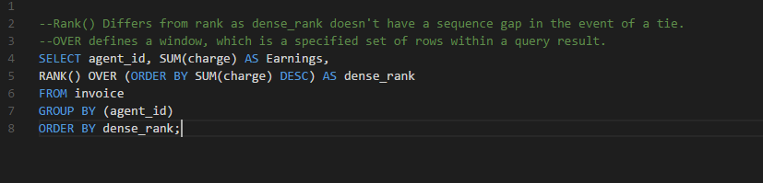
Scenario 5: User wishes to know how they rank in terms of total pay earned compared to other agents.
-Using RANK() to rank agents based on total pay received.
-dense rank gets rid of sequence gaps during a tie.
-OVER defines a window.
-Advanced subquery

Slide 14
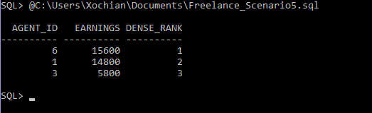
Scenario 5: (output)

Slide 15
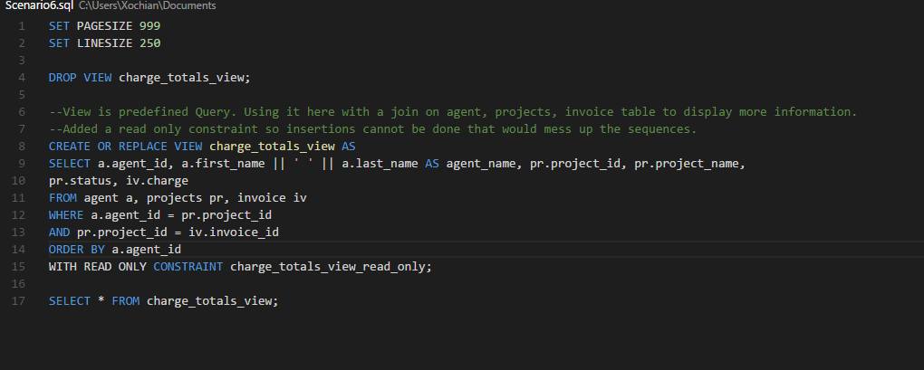
Scenario 6: Admin wishes to see information on an agent with their current project information.
-View is predefined query.
-Being used to define a three table join on agent, projects, invoice.
-Displaying more information.

Slide 16
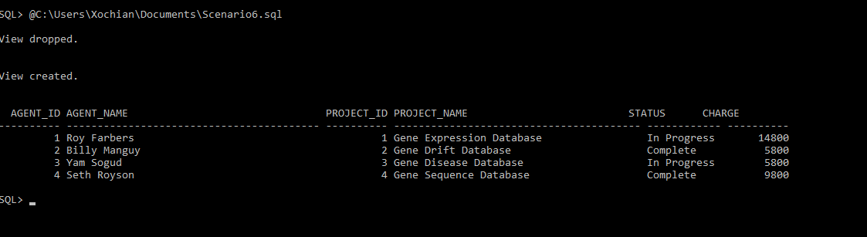
scenario 6: (Output)

